Slide 1
Hate Groups/Crimes and their Correlation with Demographics
Leigh Wright
Jeremy Kelly

Slide 2
Motivation
The amount of hate groups/crimes has risen in the recent past
We were seeking to understand correlations to hopefully aid in discovering what has caused this rise

Slide 3
Data
Data from the Census Bureau
Data from the FBI
Data from Southern Poverty Law Center

Slide 4

Big Data Framework
Ran Jupyter Notebook on Dask distributed scheduler, Raspberry Pi cluster (Pandas, Numpy, Matplotlib)
Dask – a flexible parallel computing python library for analytical computing.
Great to process large data sets with focus on lazy compute and Dask represents parallel computations with task graphs
Basically, Dask is great for doing Data Science using Python on a Raspberry Pi

Slide 5
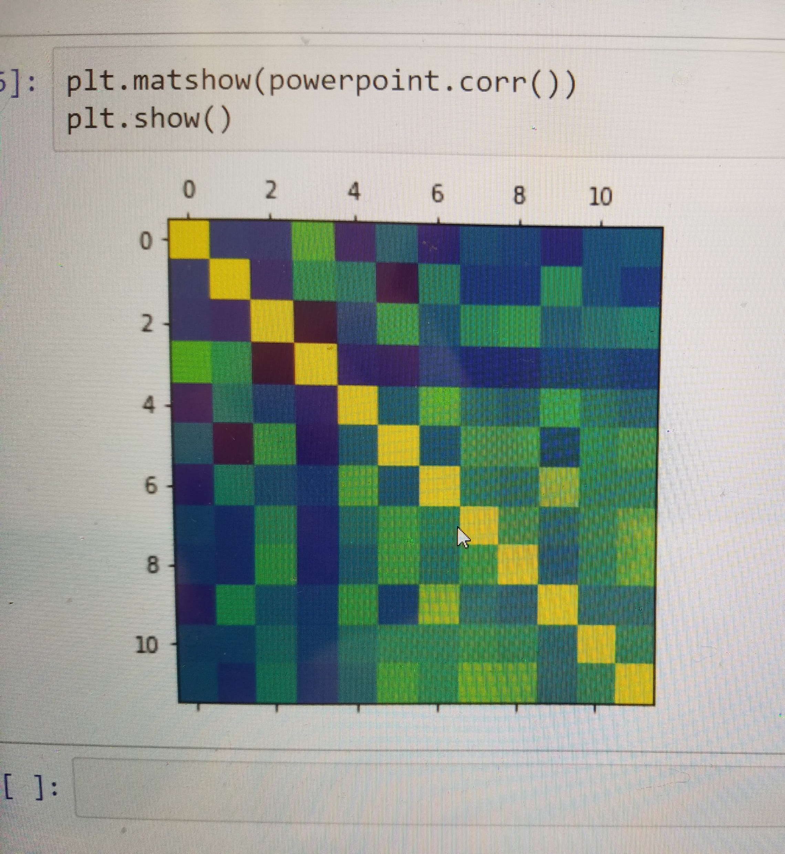
Testing the Data
Census Bureau, Hate Map, FBI, SPLC data were all cleaned
Correlations and Correlation Matrices were run

Slide 6
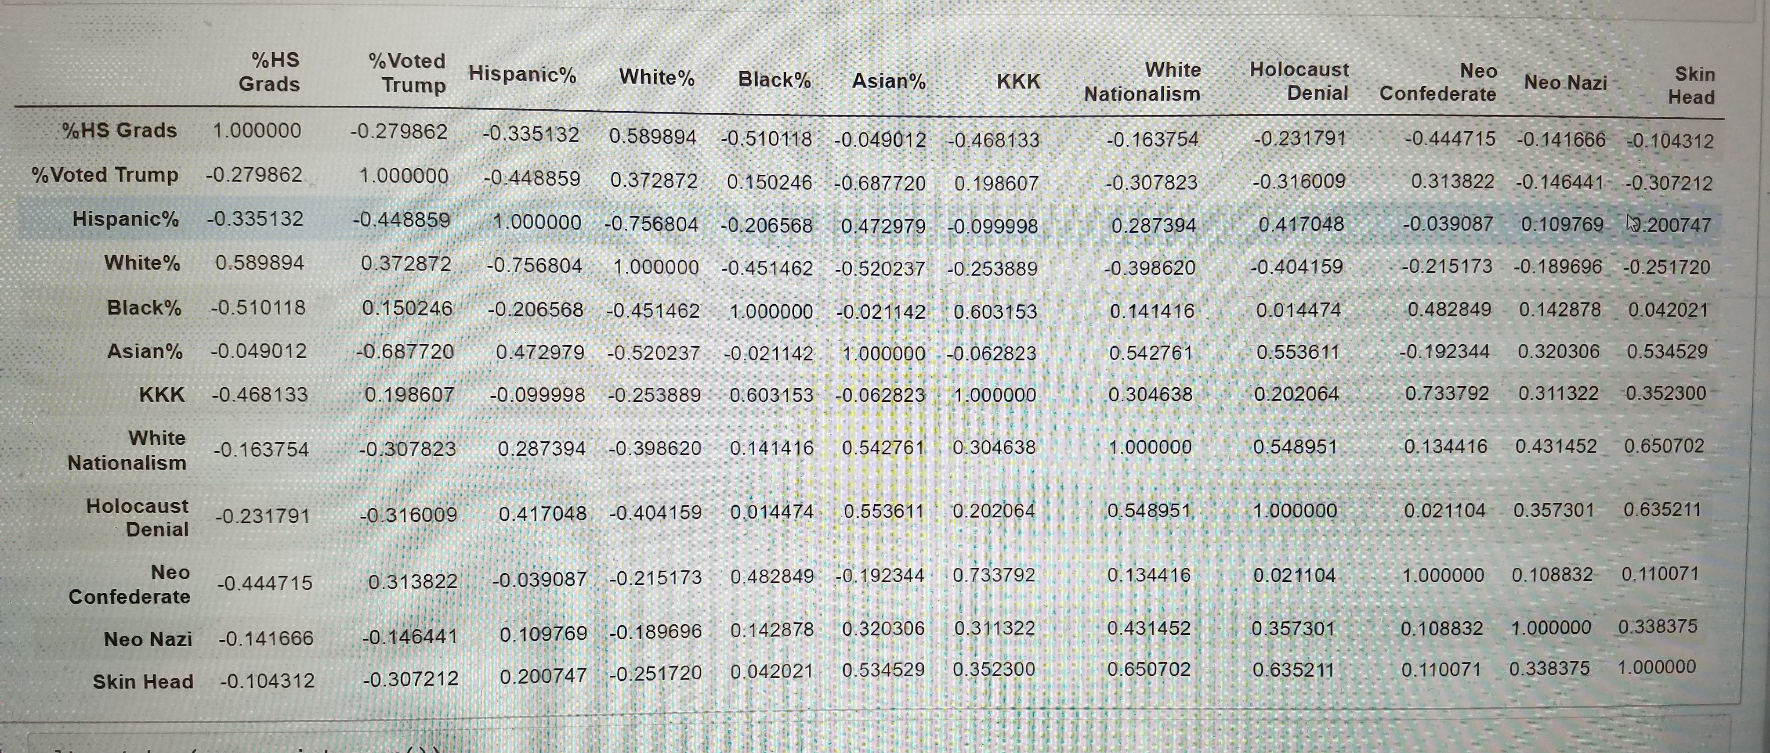
Conclusions
Data was inconclusive
Example: % Voted Trump correlated positively with KKK, but negatively with Neo Nazis and Skin Heads
Certain states may not have collected/documented data properly (MS had one reported hate crime)
Left out states with less than 1 million people or incomplete data (Hawaii)

